Slide 1


Business Insight 360
AtliQ Hardware is a rapidly growing computer hardware company based all over the world. Atliq manufactures computer peripherals includes desktop, printers, keyboards, mouse, cables and other essential accessories.

Slide 2
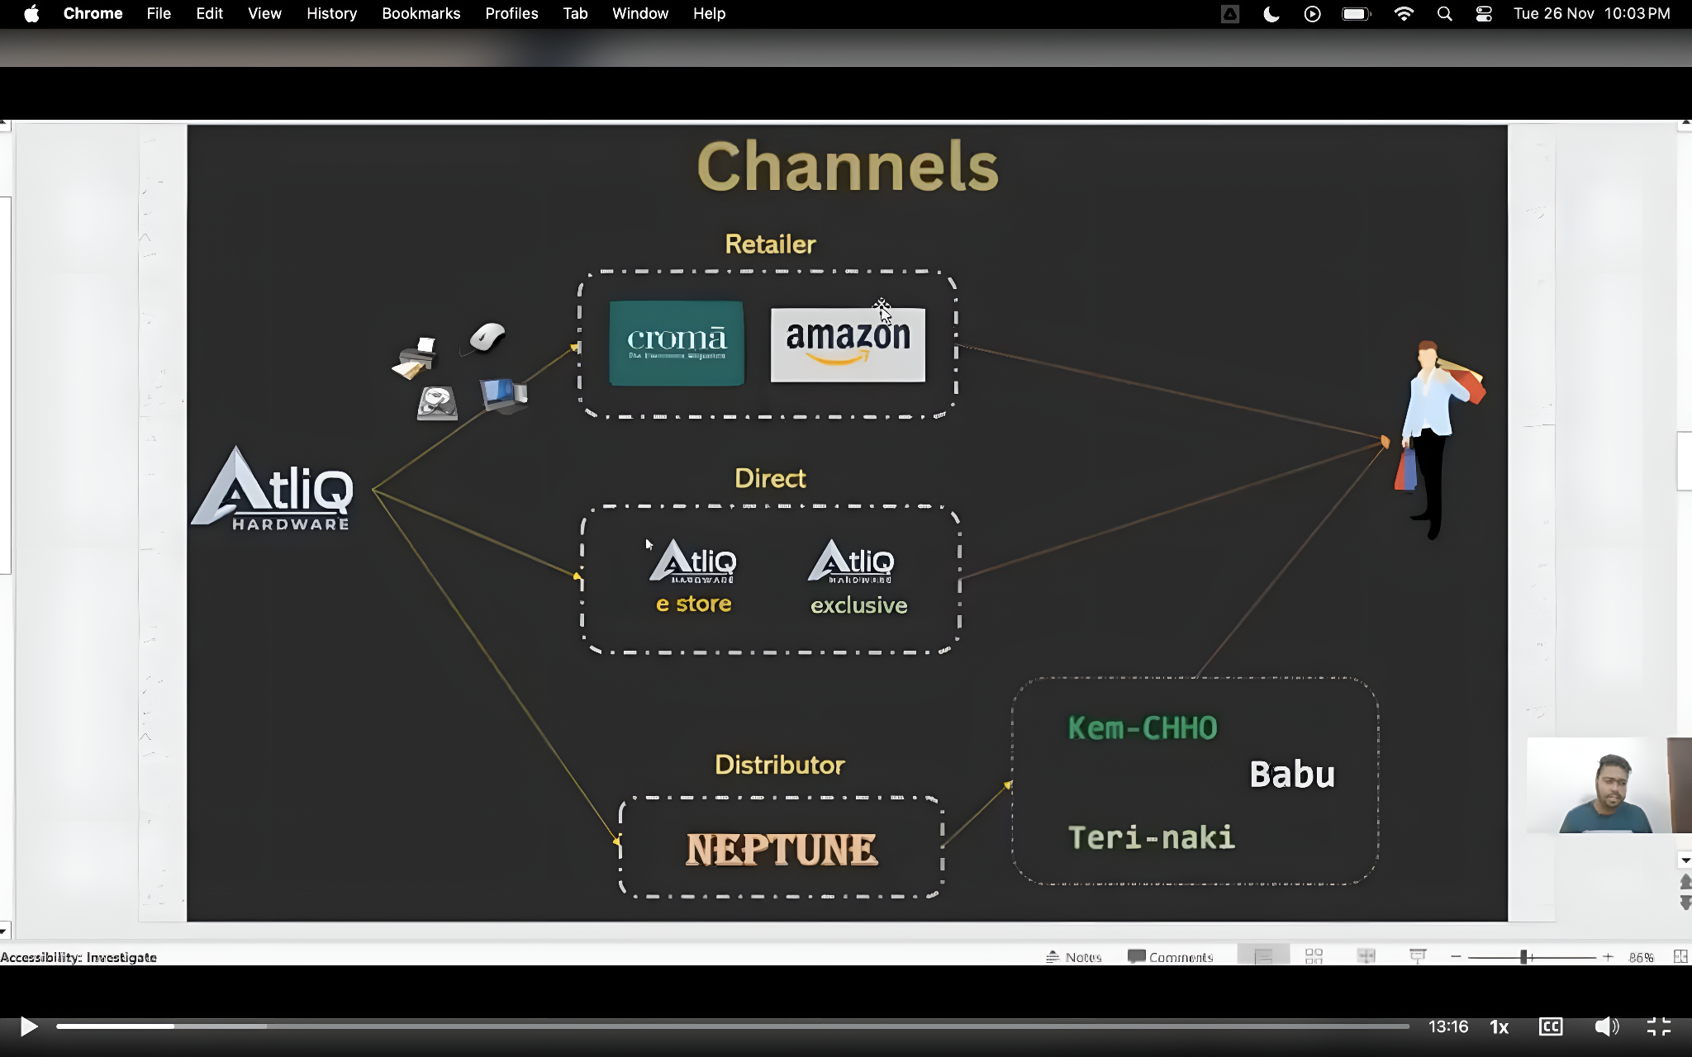
Channels
Consumer

Slide 3
𝐏𝐫𝐨𝐛𝐥𝐞𝐦 𝐒𝐭𝐚𝐭𝐦𝐞𝐧𝐭: AtliQ Hardware, a rapidly expanding global consumer electronics company, has been grappling with unwieldy Excel files for data analytics. This outdated approach has been hindering effective decision-making and causing significant losses. In response, they urgently sought agile, data-driven decision-making. 𝐎𝐛𝐣𝐞𝐜𝐭𝐢𝐯𝐞: Develop an interactive report offering invaluable insights across finance, sales, marketing, supply chain, and executive teams, using provided mockup dashboards as a reference.

Slide 4
Requirement
Finance Team
Sales
Team
Marketing
Supply Chain
Executive View

Slide 5




ETL Pipeline
Database
Extract
Load
Transform
Data Model
Excel Files
PowerBI App

Slide 6
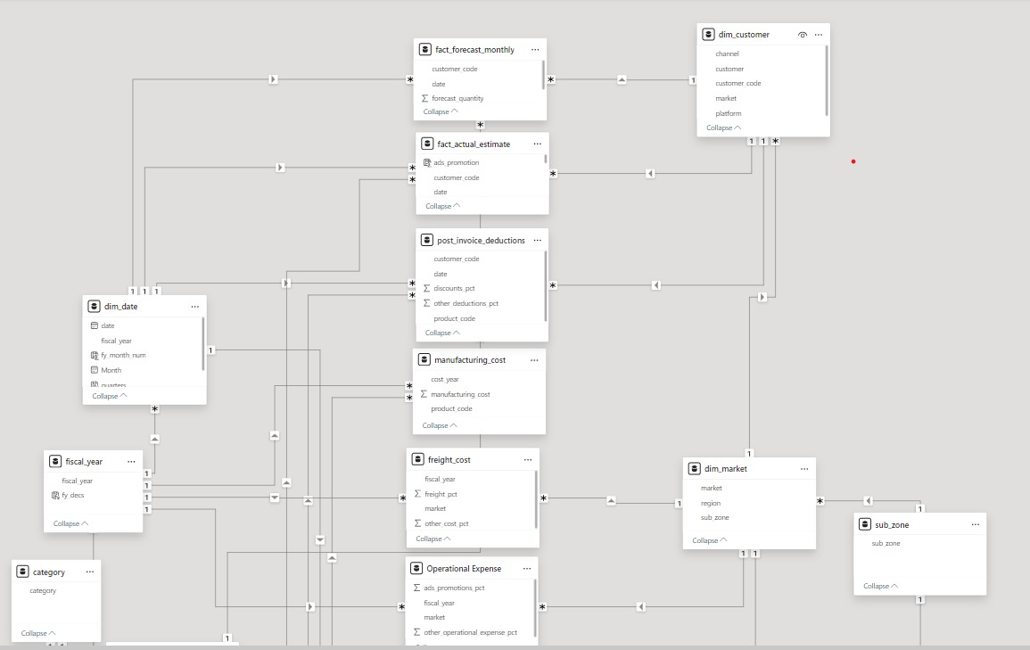
Data and its Modelling

Slide 7
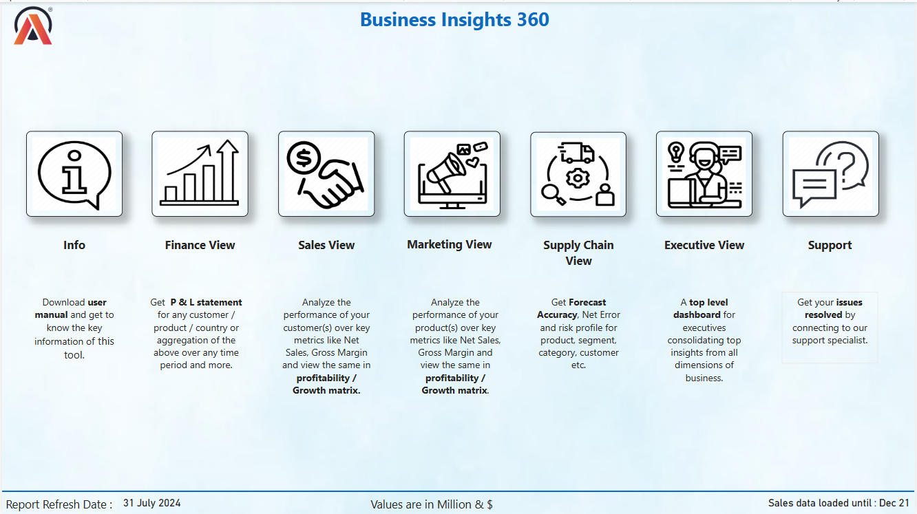

Slide 8
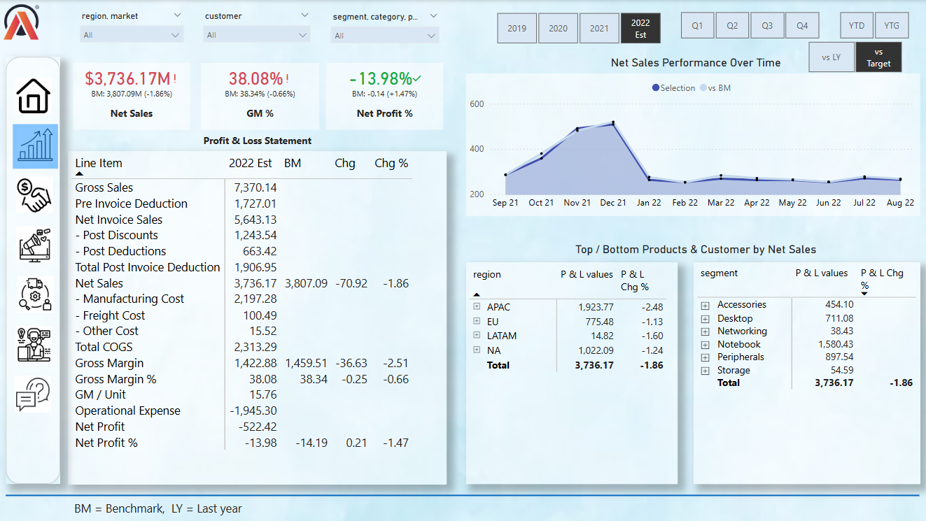

Slide 9
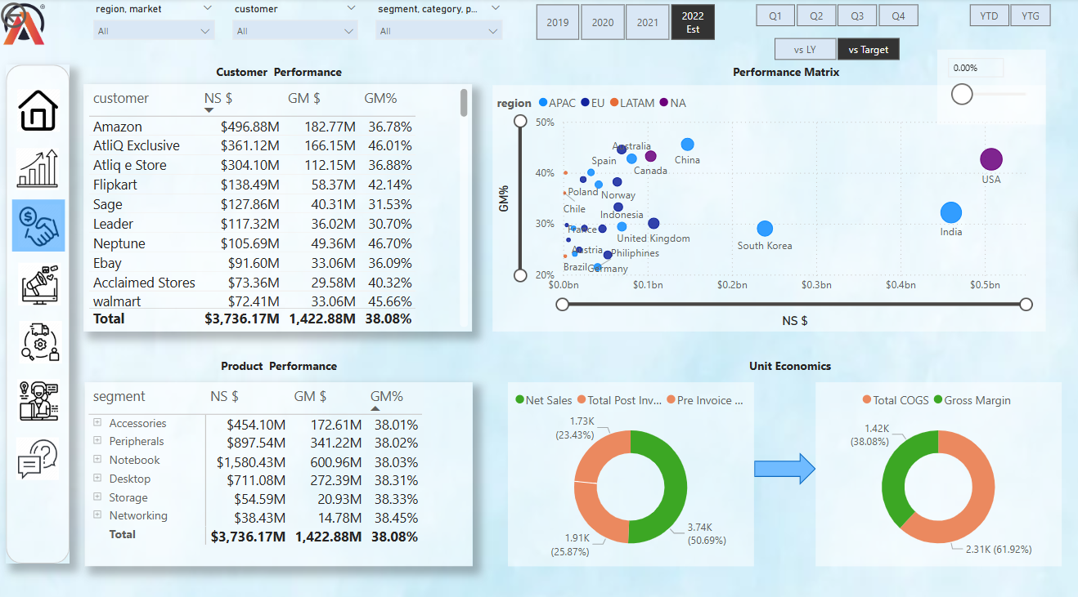

Slide 10
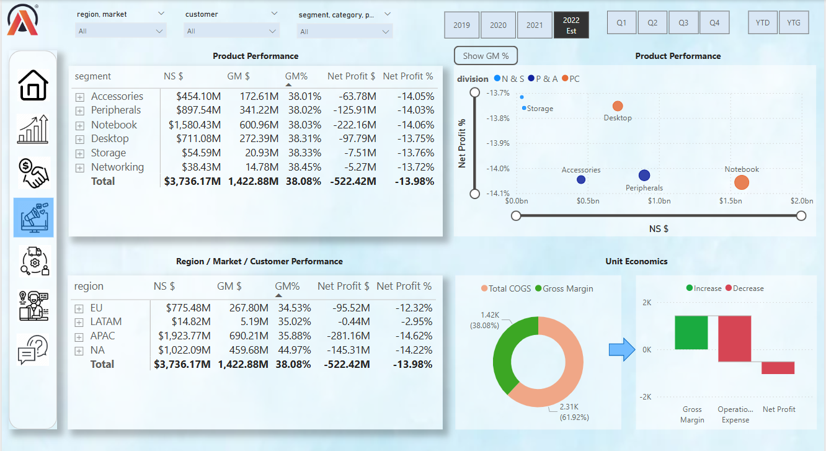

Slide 11
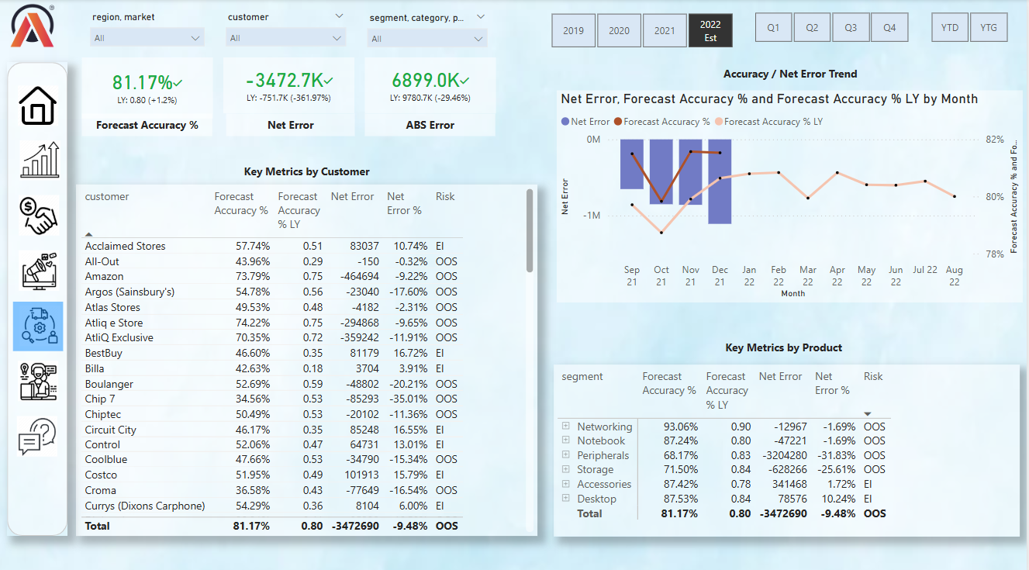

Slide 12
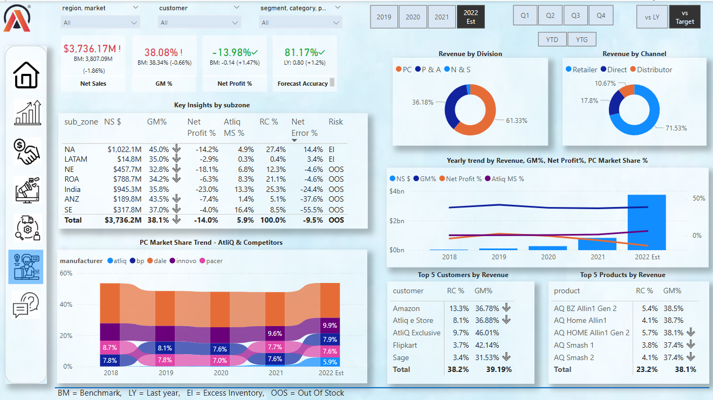

Slide 13
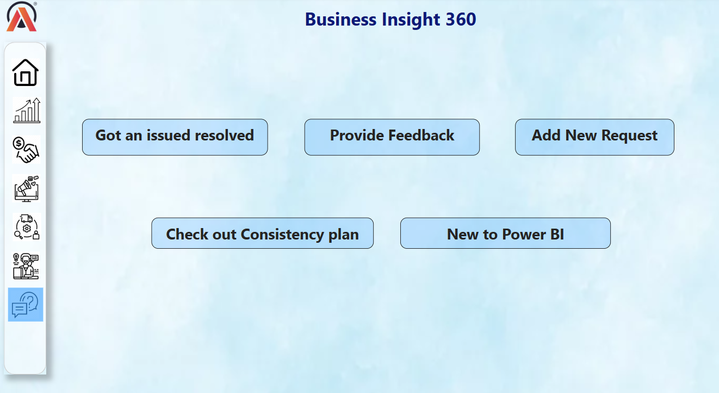

Slide 14
THANK YOU !
For Live Dashboard : CLICK HERE

